Slide 1

Blood Bank System
Department of Computer Science and Engineering​
SRM University AP.

Slide 2
Introduction
Blood transfusions are an essential component of modern medicine, aiding in emergency situations, surgical procedures, and treatments for various medical conditions. However, the efficient management of blood supplies remains a significant challenge for healthcare organizations worldwide.
This is where the Blood Bank System steps in, aiming to revolutionize the way we manage our blood resources. Through the integration of advanced technology and robust infrastructure, this system offers a comprehensive solution that addresses the key aspects of blood donation and distribution, ensuring an efficient and reliable supply chain.
The Blood Bank System is a project created to reduce the difficulties that this current manual record-keeping method has. The major goal is to enable the user to conduct operations in a simple and effective manner.

Slide 3
Introduction
The program has been made as simple as possible to prevent mistakes while entering data, and it alerts us when we enter data that is incorrect, demonstrating how user-friendly the project is.
The project is developed in such a way that it works for a blood bank to maintain its records and to add and delete donor information.
This project will help any organization in better utilization of resources and the main scope is that this project is designed to assist in strategic planning.
This project will be made some changes later on and will be a site that will be used online.

Slide 4
Introduction
Technological stack
1.Programming Languages:
Backend: PHP
Frontend: HTML, CSS, JavaScript
2. Database
MYSQL
Intended Audience
Direct Stakeholders:
Administrator
Donor/Employee
User

Slide 5
Existing System
Blood Bank Management
Web-Based Blood Bank Information Management System
Red Cross blood donation
Blood Bank Management System Using Rule-Based Method
UBlood - Find Blood Donors Online

Slide 6
Advantages and disadvantages of the existing systems
Advantages
Disadvantages
Lifesaving Potential- providing a steady supply of blood for transfusions during emergencies
Blood Safety- rigorous screening and testing protocols to ensure the safety of donated blood
Inventory Management- effective tracking and management of blood inventory
Standardization and Regulation
Donor Management
Supply and Demand Imbalance
Cost and Resource Constraints
Communication and Coordination
Security Concerns
The database is stored manually, so errors may occur.​

Slide 7
System requirements
Software Requirements:
Apache Server 2.0
PHP version 5.3 or above
MySQL Version 5.5 or above
Latest browser : Chrome, Firefox, Safari etc
Operating System : Any(Linux, Windows, Mac etc)
Hardware Requirements:
Core i5 processor
2GB Ram
20GB of hard disk space in terminal machines
500GB hard disk space in Server Machine

Slide 8
Examples of how AI and ML research can enhance Blood Bank System.
Donor Matching and Blood Compatibility
Predictive Inventory Management
Fraud Detection and Quality Control
Real-time Monitoring and Alert Systems
Disease Outbreak Surveillance
Optimization of Transportation and Delivery

Slide 9
Proposed Scheme
The proposed scheme for the blood bank system aims to address the limitations of
the current system and enhance the efficiency, accuracy, and safety of blood
donation and transfusion processes.
The key components of the proposed scheme include Donor Management, Inventory Management, User Management, and other functionalities.
Real-time inventory management with expiration date tracking and stock replenishment alerts.
Robust data security measures to protect sensitive donor and patient information.
Integration with other healthcare systems and electronic health records.

Slide 10
System architecture
The project Blood Bank System is created as a client-server application that uses a web browser. The following elements are part of this system.
Client-side: an intuitive web interface that users, donor/employees and administrators can utilize.
Server-Side: A strong server infrastructure to manage system operations and process data as well as answer user requests.
Database: A consolidated database for data on donor medical and personal details, new user details, donor/employee details.

Slide 11
Admin Management
User Management
Donor Management
Admin Login
View staff details
Add donor/employee information
delete donor/employee information
edit donor/employee information
User registration
User can check blood availability
User can contact
User can see members in the blood bank
Donor Login
Add new donor
Search for donors

Slide 12

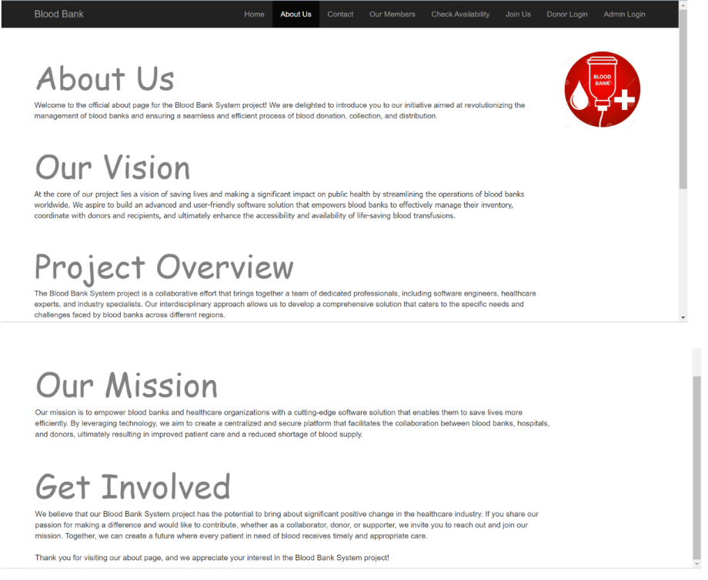
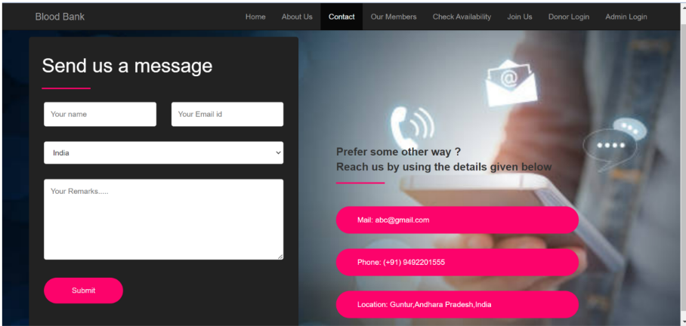
Results/Screenshots

Slide 13
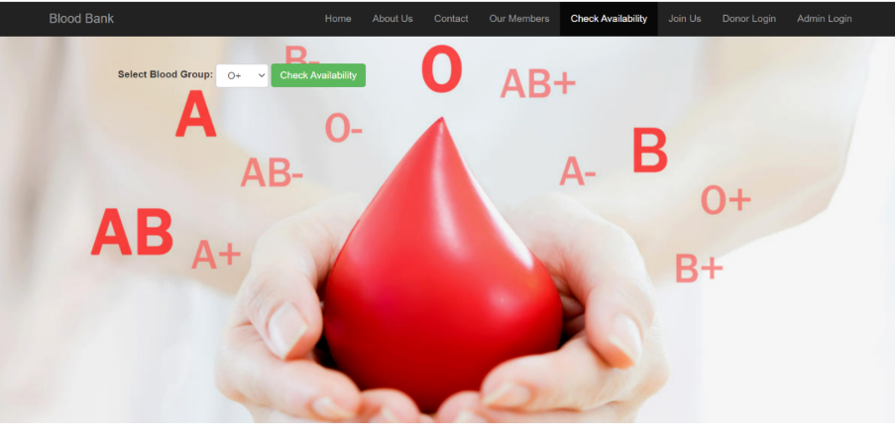
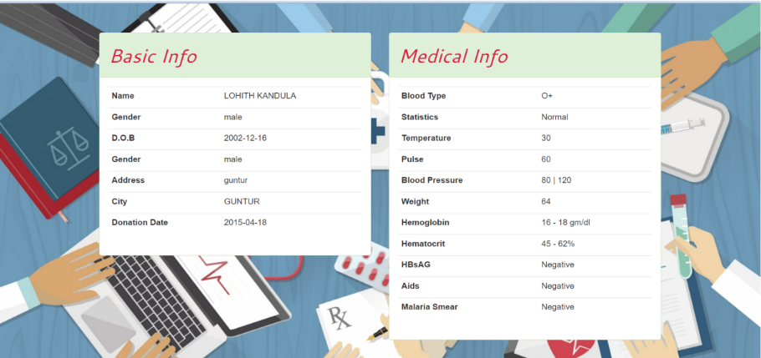
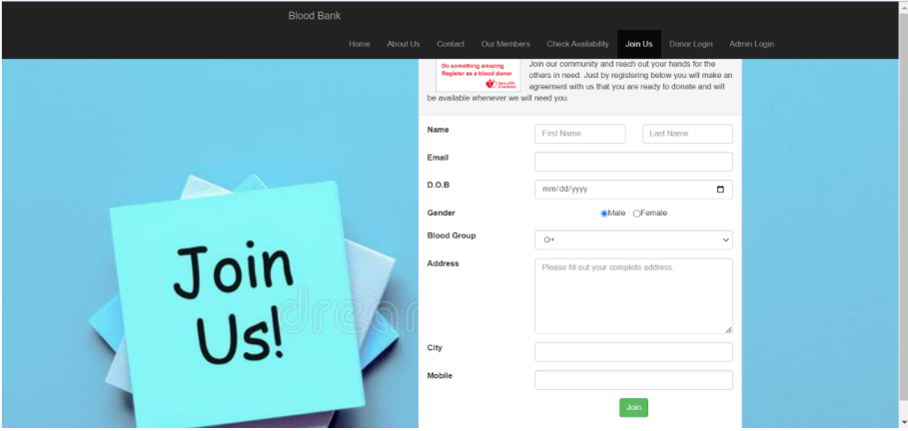
Results/Screenshots

Slide 14
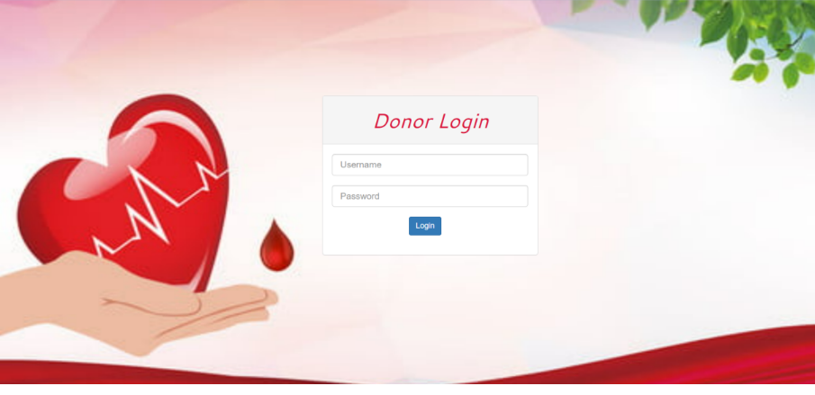
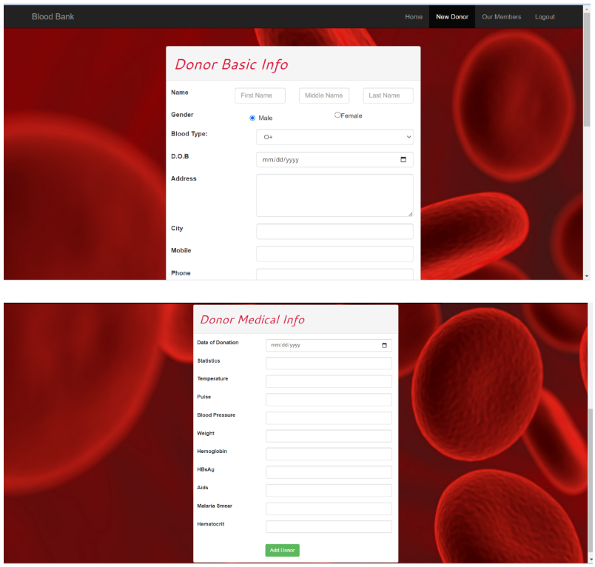
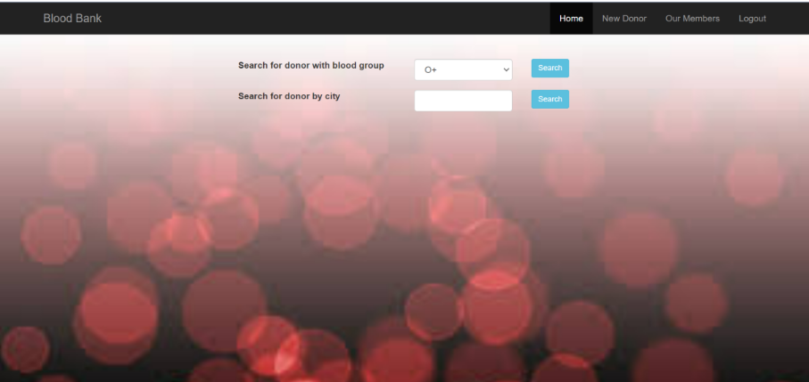
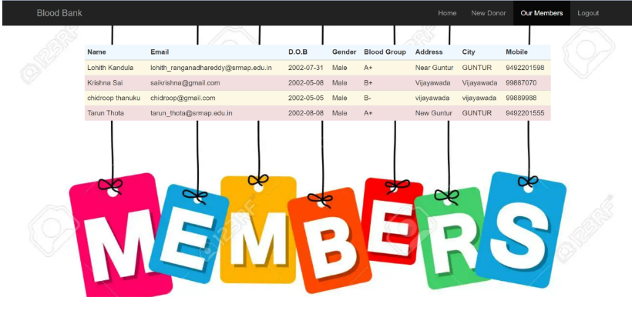
Results/Screenshots

Slide 15
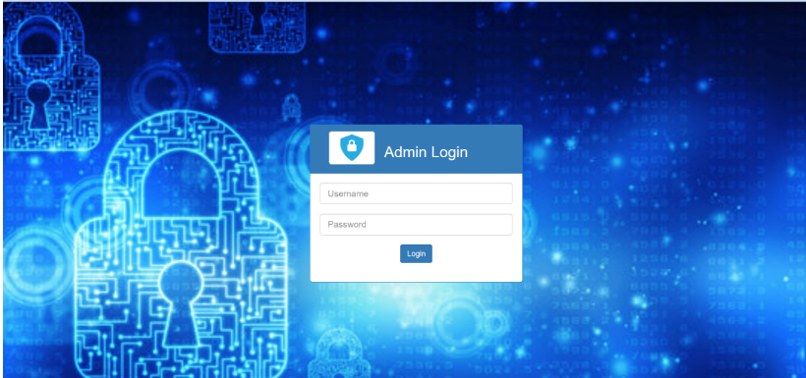
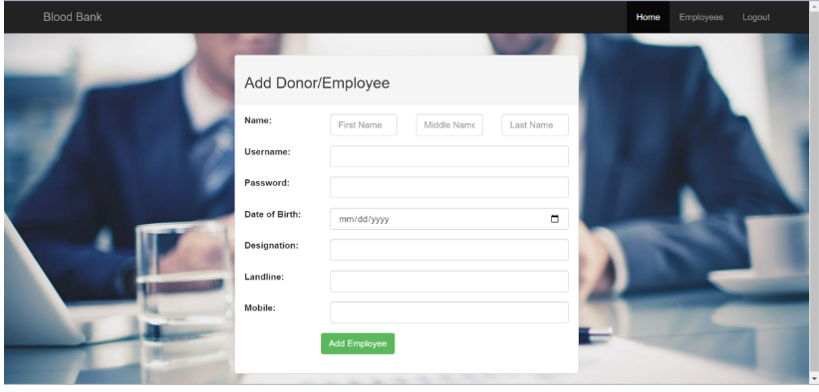
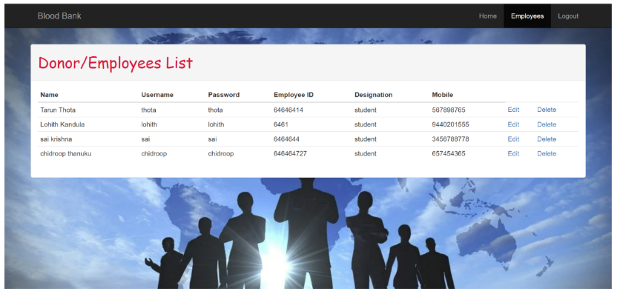
Results/Screenshots

Slide 16
Conclusion
The development of a comprehensive and efficient blood bank system is crucial for enhancing the management of donor records, improving inventory control, and ensuring the safe and timely distribution of blood products.
A web-based platform is designed to address these limitations and provide a user-friendly interface accessible to authorized personnel from any location.
The system incorporates modules for donor management, inventory control, blood request, and distribution, communication, and data security.
This project presents a significant step towards enhancing the effectiveness and reliability of blood bank operations, ultimately benefiting both donors and patients in need of life-saving blood transfusions.

Slide 17
References
https://www.idosi.org/mejsr/mejsr19(8)14/21.pdf
https://ijariie.com/AdminUploadPdf/Blood_Bank_Management_System_ijariie6874.pdf
https://www.sciencedirect.com/science/article/pii/S1877042815036940
http://etd.aau.edu.et/handle/123456789/14414
https://www.studocu.com/in/document/savitribai-phule-pune-university/msccomputer-science/blood-bank-system-managment/25462766

Slide 18
Thank You

